Slide 1

Resorts ONLINE
A Digital Online Guide:
A better way to enjoy your world as an Explorer.

Slide 2
MY STATEMENT
For far too long, resort projects have been driven by passion instead of astute commercial sense. We believe that some of the positive socio-economic conditions discussed above have opened an investment-worthy environment for resorts. Independent investors, family offices and even some hotel management companies are actively reviewing investments into leisure destinations.
This notwithstanding, some exciting trends have been observed in hotel development, operation and consumption, which point to the serious emergence of resorts as a credible investment class

Slide 3

TECHNOLOGIES USED

Slide 4

HOW TO FIND A GOOD RESORT NEAR BY YOU!?
Reduce time to search for a guide
Decide A Destination
Set Goal And Create A Plan

Slide 5
FEEL VACATION TO THE FULLEST

Slide 6



RESORTS INFO AND BOOKING
LOGIN TO THE RESORTS INFO
1
GO TO SERVICE PAGE
2
FIND LOCAL ATTRACTIONS, FOOD VENUES AND ACTIVITIES
3

Slide 7
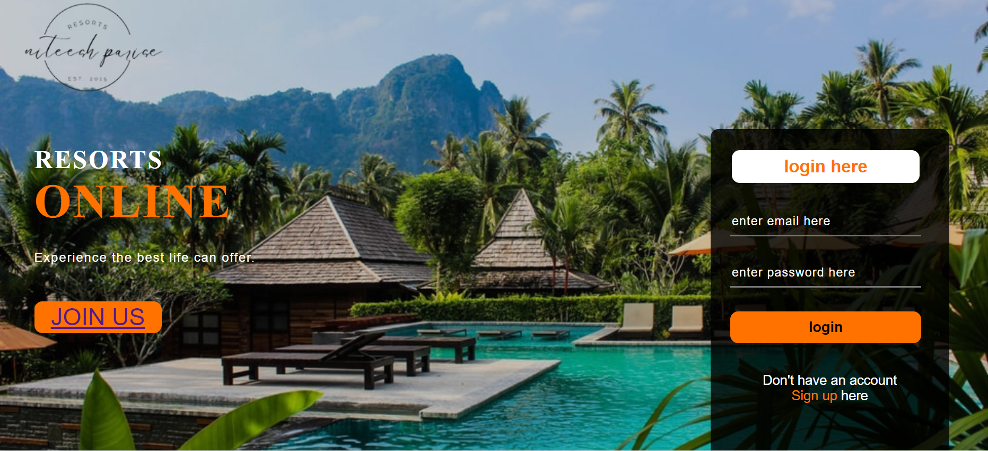
LOGIN PAGE

Slide 8

HOME PAGE

Slide 9
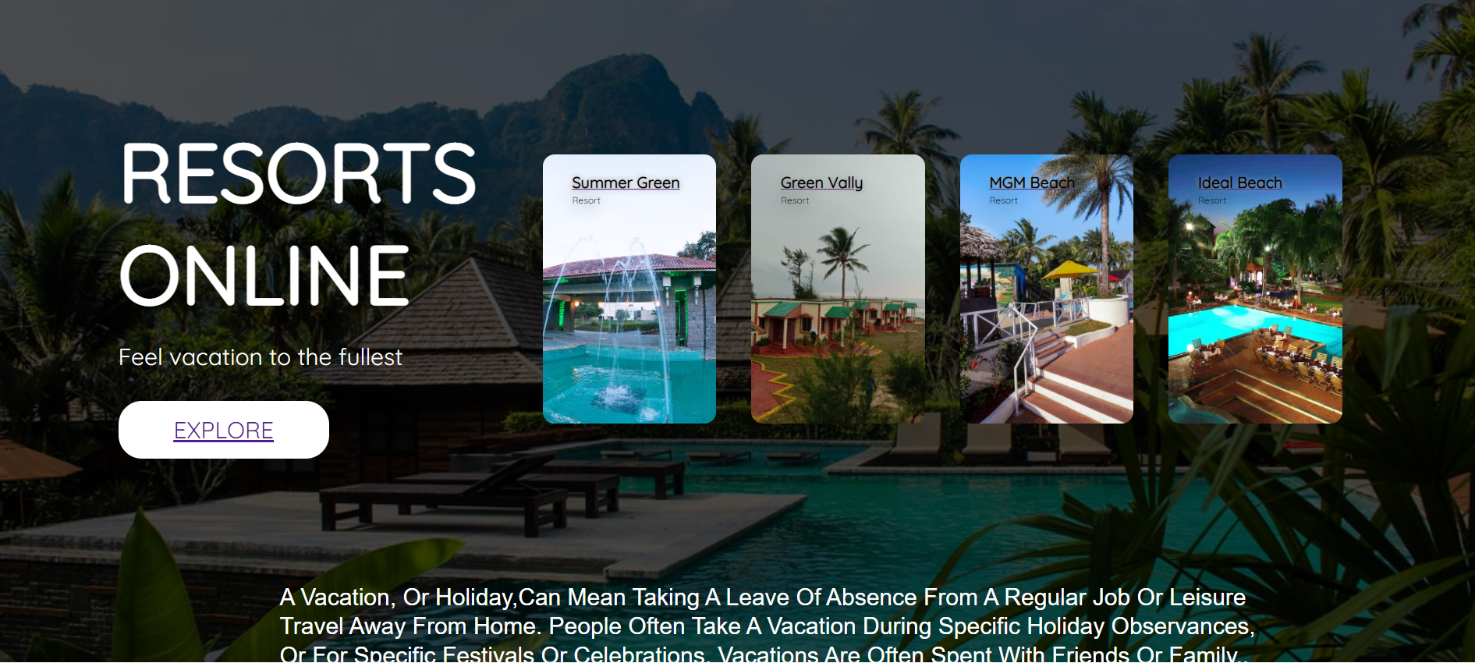
SERVICE PAGE

Slide 10
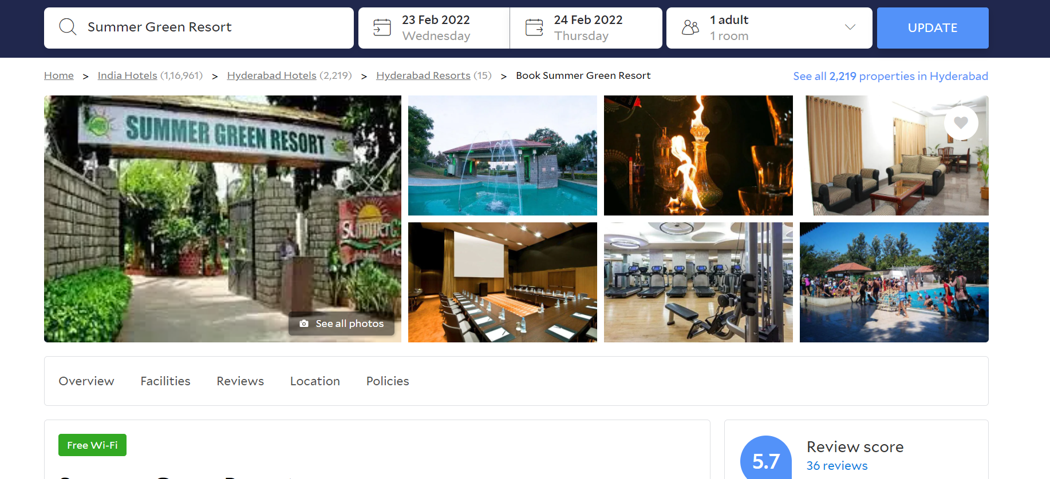
BOOKING PAGE

Slide 11

ABOUT

Slide 12

Thank you
@NiteeshParise
20761A05B1

